Slide 1

Unix tips and tricks

Slide 2
Becoming the Computational Guru of your dreams
Most computational science is not done by GUI
GUI : Graphical User Interface

Slide 3
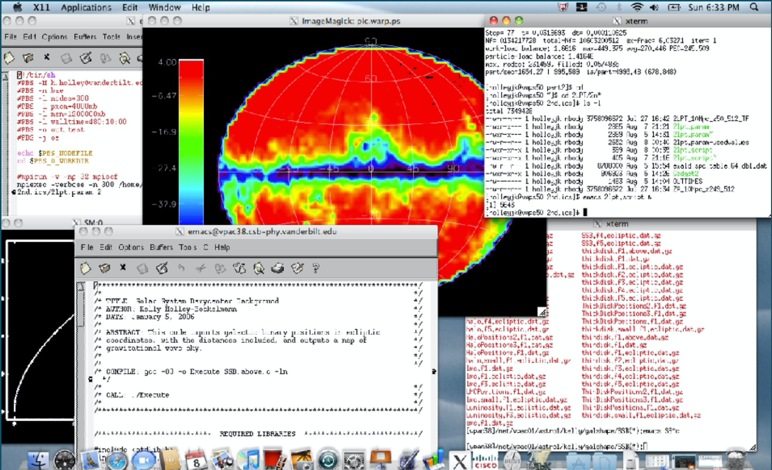
Becoming the Computational Guru of your dreams
A typical science session

Slide 4



Becoming the Computational Guru of your dreams
Scientific workstations use a UNIX-based operating system

Slide 5
Why UNIX?
Multitasking
Multiuser
Access data stored in another computer
Able to store large data sets

Slide 6
Becoming the Computational Guru of your dreams
Bash shell
Program whose primary purpose is to read commands and run other programs.
Pros: high action-to-keystroke ratio, automating repetitive tasks, accessing network machines
Cons: Cryptic commands

Slide 7
Becoming the Computational Guru of your dreams
Bash shell
It all starts with a $
If the shell can’t find a program whose name is the command you typed the error message will read ‘command not found’

Slide 8
Bash shell
What it looks like :

Slide 9
Bash shell online
https://tinyurl.com/terminalproject2021
Or
Open Terminal on your Mac
Download shell-lesson-data.zip
https://tinyurl.com/shelldata
Save it on your Desktop

Slide 10
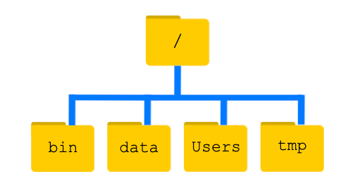
Becoming the Computational Guru of your dreams
Bash shell
/ is the root dir
Otherwise it’s a path separator (opposite of Windows)
Absolute (from root) vs relative path (from current location)
.. & . are special dirs.

Slide 11
Becoming the Computational Guru of your dreams
Getting around the directory tree
ls ➛ lists content of directory
pwd ➛ print working directory
cd ‘blah’ ➛ change directory to ‘blah’
mkdir ‘blah’ ➛ make directory ‘blah’
rmdir ‘blah’ ➛ remove directory ‘blah’
Practice: What directory are you in?
Practice: If on your computer, navigate to your Desktop directory
Practice: make a directory called ‘Hello_World’
Practice: Go inside your new directory
*Hint use tab completion *

Slide 12
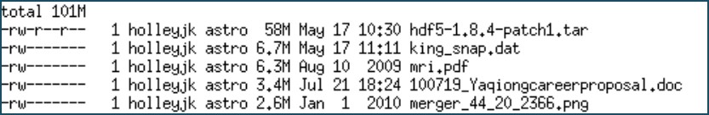
Becoming the Computational Guru of your dreams
Feel the power: adding tags to your command can customize it.
ls ➛ lists content of directory
ls -l ls -a
ls –lhS
ls -F
long format list all files
long format, file size is ‘human readable’, sorted by file size

Slide 13
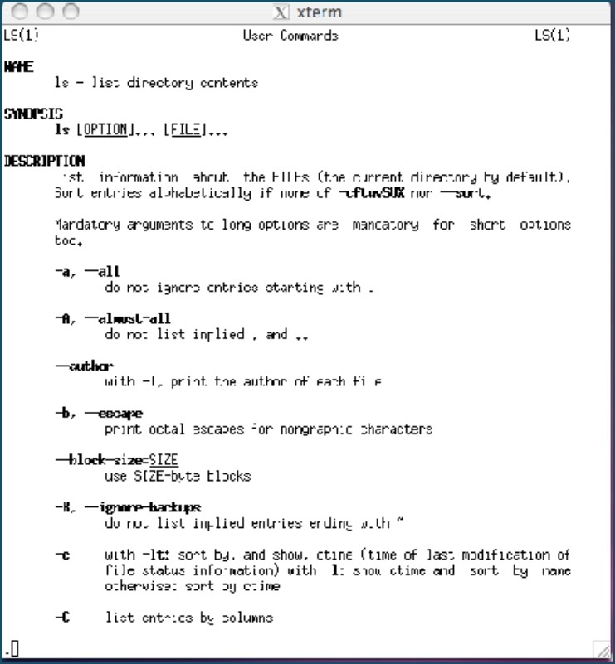
Becoming the Computational Guru of your dreams
Day 2
But how do I know the secret tags for each command?
man command
man intro is a good place to start!

Slide 14
Key Points
The file system is responsible for managing information on the disk.
Information is stored in files, which are stored in directories (folders).
Directories can also store other directories, which then form a directory tree.
cd [path] changes the current working directory.
ls [path] prints a listing of a specific file or directory; ls on its own lists the current working directory.
pwd prints the user’s current working directory.
/ on its own is the root directory of the whole file system.

Slide 15
Key Points
Most commands take options (flags) that begin with a -
A relative path specifies a location starting from the current location.
An absolute path specifies a location from the root of the file system.
Directory names in a path are separated with / on Unix, but \ on Windows.
.. means ‘the directory above the current one’
. on its own means ‘the current directory’.

Slide 16
Making and adding files
With Terminal you can write scripts, documents using vim*
Practice: On you bash shell type vim Hello.txt
You should have an empty text document
To write using vim.
Hit i on your keyboard (insert)
Type your string Hello world
Hit esc on your keyboard to stop writing
Hit :wq on your keyboard to write and quite the text file
Repeat the steps and make a empty text file
Back in bash ($) see if your text files are there with ls
*Vim is a text editor, people both love it and hate it.
If you have a prefer text editor feel free to use that one.
- Try: Open hello.txt

Slide 17
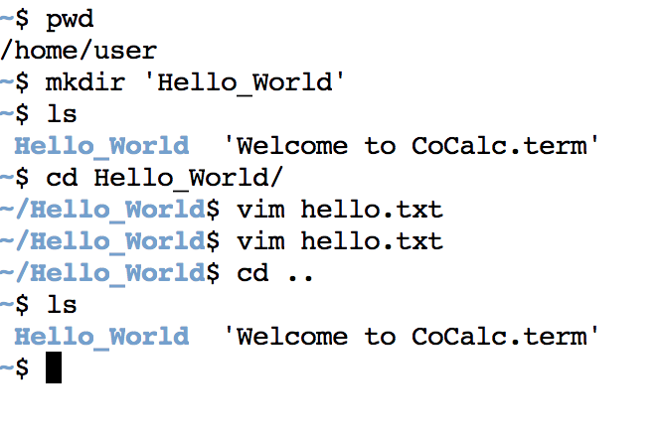
Current directory
Make directory
List things inside directory. Hello_World is bold because it’s a directory
Change to the Hello_World directory
Create hello.txt
Go back one directory

Slide 18
Becoming the Computational Guru of your dreams
Day 2
Manipulating files
cp file1 file2 ➛ copy ‘file1’ to ‘file2’
mv file1 file2 ➛ move ‘file1’ to ‘file2’
rm ‘blah’ ➛ remove file ‘blah’
*Terminal has no trash bin!
~ means /home/username/
. means the current directory
.. means go back 1 directory
* means wildcard
More reading: lookup wildcards or globbing patterns

Slide 19
Copy a file
Practice: Copy a file
To copy hello_world.
cp hello_world.txt hello_world_2.txt
or
cp hello_world.txt [path/filename]
Are the files the same?
/Users/carrile/bootcamp2023_material/day 7 - github/git_github.pptx
Hint: diff hello_world.txt hello_world_2.txt

Slide 20
Move a file
Practice: Move a file
To move hello_world up one directory
mv hello_world.txt ..
or
mv hello_world.txt [path/filename]
What is the new path for hello_world.txt?

Slide 21
Copy a directory
Practice: Copy a directory
To copy Hello_world
cp –r Hello_world Hello_world_backup
List both directories
ls Hello_world Hello_world_backup
We can also copy a directory and all its contents by using the recursive option -r

Slide 22
Move a directory
Practice: Move a directory
Make a directory called Research_Test inside Hello_World folder
mkdir ~/shell-lessons-Crisel-1/Hello_world/Research_Test
Inside Hello_world > mkdir Research_Test
To move Research_Test to shell-lessons-Crisel-1
mv Research_Test/ ~/shell-lessons-Crisel-1/

Slide 23
Remove a file
Practice: Remove a file/Delete a file (forever)
Go to your Hello_World folder
Remove hello_world_2.txt
rm hello_world_2.txt
List all files
Is hello_world_2.txt in your directory?
What happened if you try:
rm -i Hello_world/hello_world.txt

Slide 24
Remove a directory
Practice: Remove a directory and everything inside it
Remove your Hello_World directory safely
rm -ri Hello_World/
List the items in your directory and make sure you don’t have the Hello_World folder

Slide 25
Operations with multiple files and directories
Practice: Go to shell-lesson-data-YourName/molecules/
* Wildcard matches characters
List all the files inside the molecules/ directory
Try it out : Which command(s) will produce this output?
ethane.pdb methane.pdb
ls *t*ane.pdb
ls *t?ne.*
ls *t??ne.pdb
ls ethane.*

Slide 26
Key Points
cp [old] [new] copies a file.
mkdir [path] creates a new directory.
mv [old] [new] moves (renames) a file or directory.
rm [path] removes (deletes) a file.
* matches zero or more characters in a filename, so *.txt matches all files ending in .txt.
? matches any single character in a filename, so ?.txt matches a.txt but not any.txt.
The shell does not have a trash bin
Most files’ names are something.extension. The extension is used to indicate the type of data in the file.

Slide 27
Pipes and Filters
Practice: Go to shell-lesson-data-YourName
Rename shell–lesson-data to shell-lesson-data- ‘initials’
Find and cd into alkanes folder
Word Count (wc)
$ wc cubane.pdb
20 156 1158 cubane.pdb
Number of lines, words, and characters in files
Practice:
wc *.pdb
wc –l *.pdb
Save output
wc -l *.pdb > lengths.txt (open it and show in window)

Slide 28
Pipes and Filters
Check: Did you save lengths.txt ?
Peek inside lengths.txt with:
cat -‘concatenate’ i.e. join together, and it prints the contents of files one after another.
head – displays only the first 10 lines of the file
less - screenful of the file, and then stops. You can go forward one screenful by pressing the spacebar, or back one by pressing b. Press q to quit.

Slide 29
Pipes and Filters
Check: Sort
Sort lengths.txt with:
$ sort -n lengths.txt > sorted-lengths.txt
$ head -n 1 sorted-lengths.txt
Notes:
n ?

Slide 30
Pipes and Filters
Check: echo prints statement
$ echo The echo command prints text
The echo command prints text
$ echo hello > testfile01.txt
$ echo hello > testfile02.txt
$ echo hello >> testfile02.txt
what is saved in textfile02.txt?
> ‘hello’ is written to testfile01.txt, but the file gets overwritten each time we run the command.
>> ‘hello’ is appended to testfile02.txt,
Check: > vs >>

Slide 31
Pipes and Filters
Check: More commands in one line | (pipe)
$ sort -n lengths.txt | head -n 1
$ wc -l *.pdb | sort -n
$ wc -l *.pdb | sort -n | head -n 1

Slide 32
Translate this:
cp ~/*.sm ../.
mv ../density.sm
rm *
~/bootcamp/dense.s
rm -i *
i => interactive option, will prompt you before deleting anything
Notes:
cp: This is the command to copy files and directories.
~/*.sm: The tilde (~) represents the user's home directory, and *.sm is a wildcard pattern that matches all files ending with the ".sm" extension in the home directory.
../.: The ../ represents the parent directory, and . denotes the current directory. By using ../., you are instructing the cp command to copy the matched files to the parent directory (one level up from the current directory).

Slide 33
Key Points
wc counts lines, words, and characters in its inputs.
cat displays the contents of its inputs.
sort sorts its inputs.
head displays the first 10 lines of its input.
tail displays the last 10 lines of its input.
command > [file] redirects a command’s output to a file (overwriting any existing content).
echo "Hello, World!" > hello.txt

Slide 34
Key Points
command >> [file] appends a command’s output to a file.
[first] | [second] is a pipeline: the output of the first command is used as the input to the second.
The best way to use the shell is to use pipes to combine simple single-purpose programs (filters).

Slide 35
Loops
Loops are a programming construct which allow us to repeat a command or set of commands for each item in a list. As such they are key to productivity improvements through automation
i | i<= 6 | Output
2 | True | 3
4 | True | 5
6 | True | 7
8 | False
for (initialization; condition; increment/decrement) {
// Code to be executed in each iteration
}
We will cover this also with Python

Slide 36
Loops
Loops are a programming construct which allow us to repeat a command or set of commands for each item in a list. As such they are key to productivity improvements through automation
We will cover this also with Python

Slide 37
Loops
$for thing in list_of_things
do
operation_using $thing
done
Practice: Go to shell-lesson-data-YourName/creatures/
$ for name in basilisk.dat minotaur.dat unicorn.dat
do
head -n 2 $name | tail -n 1
done
Can also use semicolon for new line
COMMON NAME: basilisk
COMMON NAME: minotaur
COMMON NAME: unicorn
Notes:
$ for name in basilisk.dat minotaur.dat unicorn.dat: This line starts a loop that iterates over the three specified filenames, i.e., basilisk.dat, minotaur.dat, and unicorn.dat.
do: This keyword indicates the beginning of the loop block.
head -n 2 $name: The head command is used to retrieve the first few lines of a file. -n 2 specifies that we want to display the first 2 lines of the file whose name is stored in the variable $name.
|: This is the pipe symbol, which redirects the output of the head command to the tail command.
tail -n 1: The tail command is used to display the last few lines of a file. -n 1 specifies that we want to display only the last line of the output from the head command (which is the second line of the original file).
done: This keyword indicates the end of the loop block.
do and done not needed for zshell

Slide 38
Loops
$for thing in list_of_things
do
operation_using $thing
done
Practice: Go to shell-lesson-data-YourName/creatures/
$ for filename in *.dat
do
cp $filename original-$filename
done
Notes:
only works for single line (not using do or done)

Slide 39
Key Points
A for loop repeats commands once for every thing in a list.
Every for loop needs a variable to refer to the thing it is currently operating on.
Use $name to expand a variable (i.e., get its value).
Do not use spaces, quotes, or wildcard characters such as ‘*’ or ‘?’ in filenames, as it complicates variable expansion.
Give files consistent names that are easy to match with wildcard patterns to make it easy to select them for looping.

Slide 40
Bash scripts
How can I save and re-use commands?
Practice: Go to shell-lesson-data-YourName/alkanes/
With Terminal you can write scripts, documents using vim*
Practice: Type vim middle.sh
You should have an empty text document
To write using vim.
Hit i on your keyboard (insert)
Type your code head -n 15 octane.pdb | tail -n 5
Hit esc on your keyboard to stop writing
Hit :wq on your keyboard to write and quite the text file
Back in bash ($) bash middle.sh

Slide 41
Bash scripts
How can I save and re-use commands?
Practice: Type more general script
vim middle.sh
To write using vim.
Hit i on your keyboard (insert)
Type your code head -n 15 $1 | tail -n 5
Previously (head -n 15 octane.pdb | tail -n 5)
Hit esc on your keyboard to stop writing
Hit :wq on your keyboard to write and quite the text file
Back in bash - $ bash middle.sh octane.pdb
Back in bash - $ bash middle.sh pentane.pdb

Slide 42
Bash scripts
How can I save and re-use commands?
Practice: Type more general script
vim script.sh
To write using vim.
Hit i on your keyboard (insert)
Type your code
head -n $2 $1
tail -n $3 $1
Hit esc on your keyboard to stop writing
Hit :wq on your keyboard to write and quite the text file
Back in bash - $ bash script.sh ‘*.pdb’ 1 1
Notes:
bash script.sh octane.pdb 10 5
head -n $2 $1: The head command is used to read the first few lines of the file specified by the first argument ($1). -n $2 indicates that we want to display the first $2 lines of the file. $2 represents the second argument passed to the script.
tail -n $3 $1: The tail command is used to read the last few lines of the file specified by the first argument ($1). -n $3 indicates that we want to display the last $3 lines of the file. $3 represents the third argument passed to the script.

Slide 43
Key Points
Save commands in files (usually called shell scripts) for re-use.
bash [filename] runs the commands saved in a file.
$1, $2, etc., refer to the first command-line argument, the second command-line argument, etc.
Bonus:
chmod +x executable
./executable

Slide 44
Finding files and things inside files
Practice: Go to shell-lesson-data-YourName/writing/
Look inside haiku.txt
Which lines have contain ‘not’ ?
grep (find)
$ grep not haiku.txt
Is not the true Tao, until
"My Thesis" not found
Today it is not working

Slide 45
Finding files and things inside files
Practice: Go to shell-lesson-data-YourName/writing/
$ grep The haiku.txt
$ grep –w The haiku.txt
$ grep –w “is not” haiku.txt
$ grep –i => case insensitive
$ grep –n => number lines
$ grep –v => invert search
$ grep –r => recursive search
$ grep - - help (no space)

Slide 46
Finding files and things inside files
Practice: Lets search recursively through the whole directory shell-lesson-data-YourName/writing/
$ grep –r Yesterday
data/LittleWomen.txt:"Yesterday, when Aunt was asleep and I was trying to be as still as a
data/LittleWomen.txt:Yesterday at dinner, when an Austrian officer stared at us and then
data/LittleWomen.txt:Yesterday was a quiet day spent in teaching, sewing, and writing in my
haiku.txt:Yesterday it worked

Slide 47
Finding files and things inside files
Practice: Go to shell-lesson-data-YourName/writing/
$ grep -E “^.o” haiku.txt
We use the -E option and put the pattern in quotes to prevent the shell from trying to interpret it.
The ^ in the pattern anchors the match to the start of the line.
The . matches a single character
o matches an actual ‘o’.
(lines that start with any character
followed by "o")
^,*,+,?
cards

Slide 48
Finding files and things inside files
Practice: Go to shell-lesson-data/exercise-data/writing/
$ for sis in Jo Meg Beth Amy
do
echo $sis:
grep –ow $sis LittleWomen.txt
done
-o, --only-matching
-w, --word-regexp

Slide 49
Finding files and things inside files
Practice: Go to shell-lesson-data-YourName/writing/
$ find .
$ find . –type d
$ find . –type f
$ find . –name “*.txt”

Slide 50
Key Points
find finds files with specific properties that match patterns.
grep selects lines in files that match patterns.
[command]--help display information on how to use these commands or programs.
man [command] displays the manual page for a given command.

Slide 51
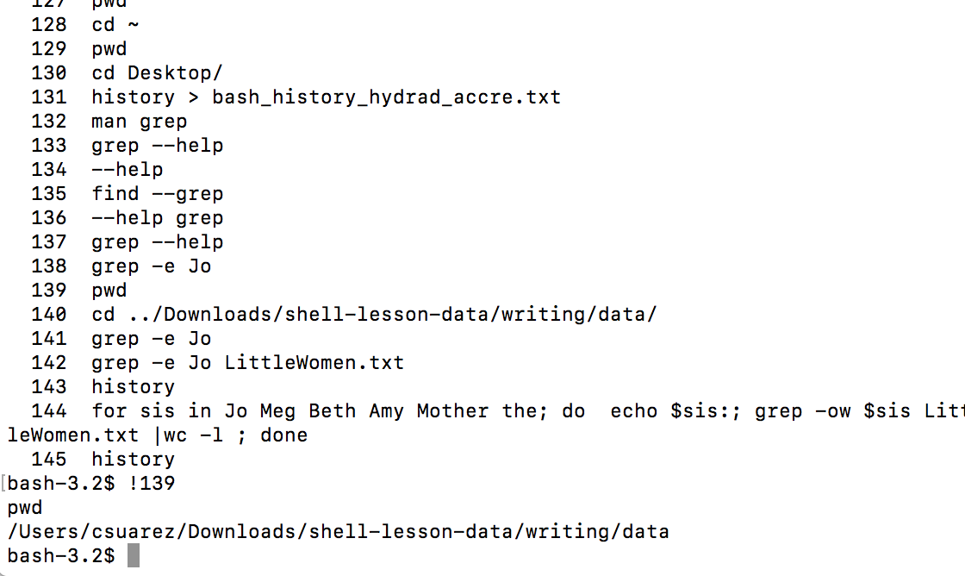
History
Save your work with history
history > history_text_file.txt
Rerun command with ! line number

Slide 52
Becoming the Computational Guru of your dreams
Day 2
Vim walkthrough
https://www.openvim.com/

Slide 53
Becoming the Computational Guru of your dreams
Day 2
Remember the cheat sheet
Cheatsheet

Slide 54
END

Slide 55
Previous years notes

Slide 56
Becoming the Computational Guru of your dreams
Day 2
Some more commands
rm -rf for directories (careful!)
Maybe make rm interactive using rm -i in
~/.aliases
history
Unpack files from arXiv : tar -xvf <filename>

Slide 57
Becoming the Computational Guru of your dreams
Day 2
Translate this:
cp ~/*.sm ../.
mv ../density.sm
rm *
~/bootcamp/dense.s

Slide 58
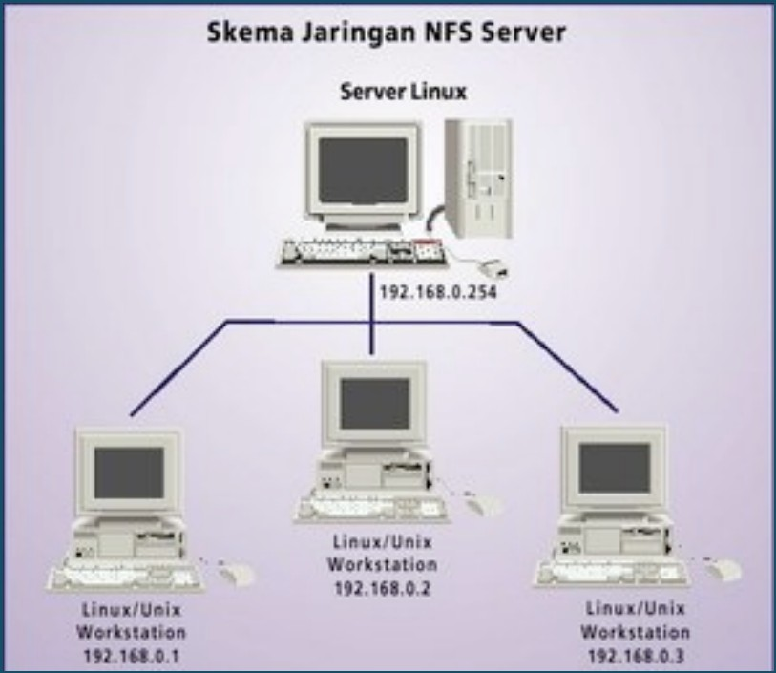
Becoming the Computational Guru of your dreams
Day 2
When you ssh into the vpac/accre network, you go to your home directory.
Your directory can be accessed through any of these network machines. And, you can (theoretically) access data on other user’s
accounts, too.

Slide 59




scp
Becoming the Computational Guru of your dreams
Day 2
secure copy protocol
remote
local
~ stands for home dir (make sure you’re in the right place!) Use * wildcard to grab multiple files that meet some condition

Slide 60


Becoming the Computational Guru of your dreams
Day 2
To log into another machine:
ssh -YC username@computer’s whole address
example: ssh -YC holleyjk@vpac03.phy.vanderbilt.edu
scp -pr complete path of file you want to move complete path
describing where you want to put it
To transfer data between machines:
example 1: scp -pr holleyjk@vpac03.phy.vanderbilt.edu:/home/holleyjk/superfile
/Users/kelly/Desktop/superfile.moo
example 2: scp -pr /Users/kelly/awesomefile holleyjk@vmplogin.accre.vanderbilt.edu:/home/holleyjk/.

Slide 61
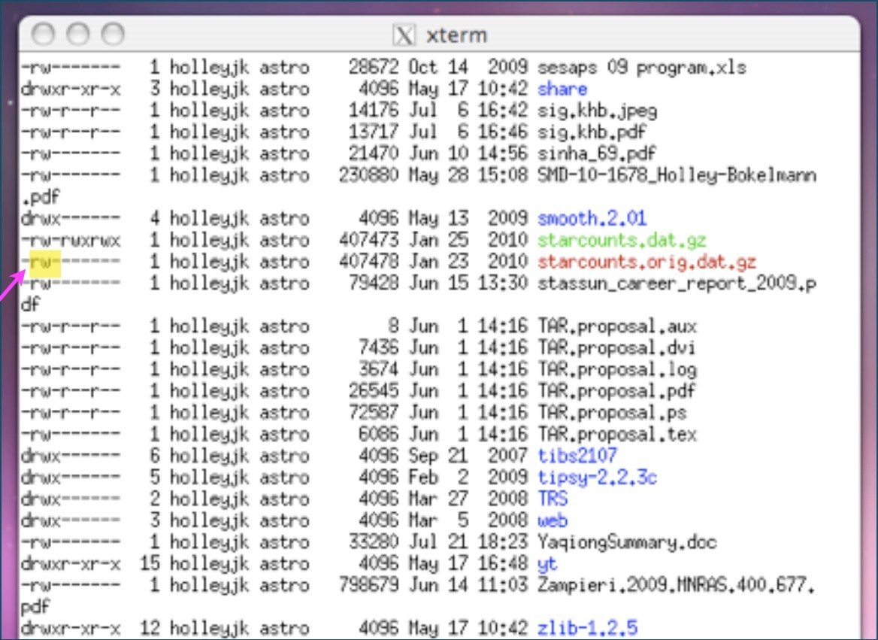
Becoming the Computational Guru of your dreams
Day 2
Your data is protected by file permissions
Aside: How did I get this list?
user permissions r=Read w=Write x=eXecute

Slide 62
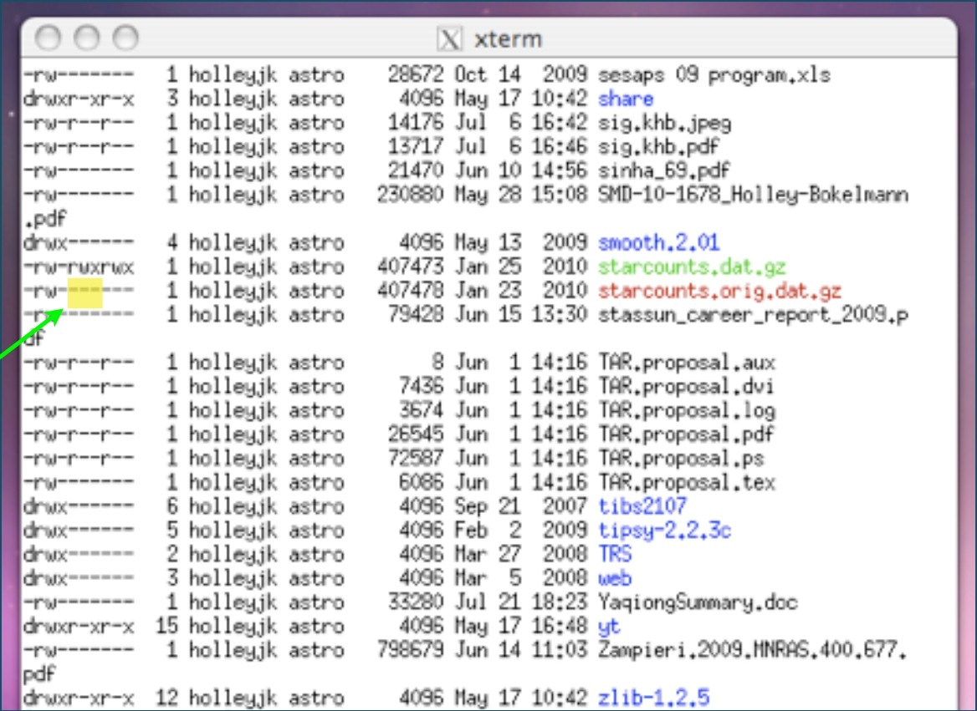
Becoming the Computational Guru of your dreams
Day 2
Your data is protected by file permissions
group permissions r=Read w=Write x=eXecute

Slide 63
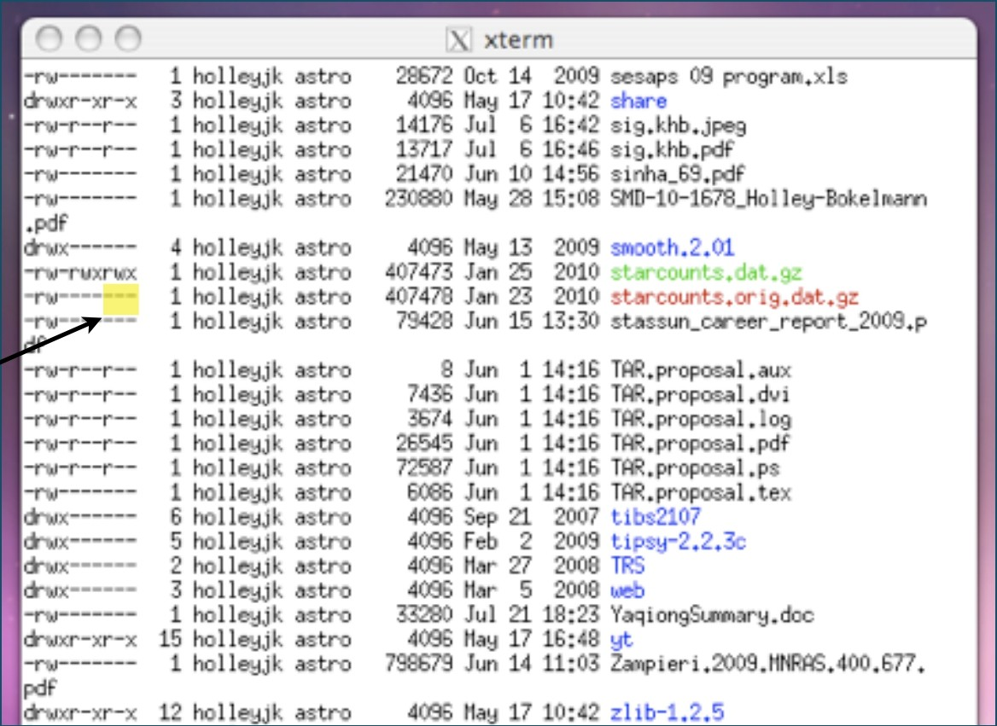
Becoming the Computational Guru of your dreams
Day 2
Your data is protected by file permissions
other permissions r=Read w=Write x=eXecute

Slide 64
Becoming the Computational Guru of your dreams
Day 2
To change permissions:
chmod ugo+/-rwx filename Example: chmod go+r pro*.dat
Advanced: chgrp -R <group> <directory>
changes the group ownership of a directory (R=recursively).
Have to be admin or be member of both groups

Slide 65
Becoming the Computational Guru of your dreams
Day 2
Taking a peek at a file:
head -n50 file ➛ displays first 50 lines of file
tail -n12 file ➛ displays last 12 lines of file
more file ➛ scrolls through file page by page Enter to scroll line by line or Spacebar to scroll ”page by page”
less file ➛ a better version of more
Practice: figure out what is the last line in
~/alias.holleyjk

Slide 66
Becoming the Computational Guru of your dreams
Day 2
Is the file compressed? Looking for a file? Try
gunzip file
find . -iname file
What jobs are running in your shell? ps
...on your machine? Need to kill a job?
htop
kill -9 PID
Need to count lines in a file?
wc -l file
Smoosh files into 1
cat file1 file2 > smooshfile
Split file into many of N bytes
split -b N file

Slide 67
Becoming the Computational Guru of your dreams
Day 2
String commands together with pipes :
try these:
ls -l /home/holleyjk | less ps aux | grep username
the possibilities are huge!

Slide 68
Seven days to becoming the Computational Guru of your dreams
Day 3
Q. List the first 5 most recently modified files in a directory in human readable format
Steps:
list all the files in the directory
list them by modification time, most recent first
display that list in human readable format
display only the top 5 in that list

Slide 69
Seven days to becoming the Computational Guru of your dreams
Day 3
Q. List the first 5 most recently modified files in a directory in human readable format
Steps:
list all the files in the directory ls -al
list them by modification time, most recent first
display that list in human readable format
display only the top 5 in that list

Slide 70
Seven days to becoming the Computational Guru of your dreams
Day 3
Q. List the first 5 most recently modified files in a directory in human readable format
Steps:
list all the files in the directory ls -al
list them by modification time, most recent first ls -alt
display that list in human readable format
display only the top 5 in that list

Slide 71
Seven days to becoming the Computational Guru of your dreams
Day 3
Q. List the first 5 most recently modified files in a directory in human readable format
Steps:
list all the files in the directory ls -al
list them by modification time, most recent first ls -alt
display that list in human readable format ls -halt
display only the top 5 in that list

Slide 72
Seven days to becoming the Computational Guru of your dreams
Day 3
Q. List the first 5 most recently modified files in a directory in human readable format
Steps:
list all the files in the directory ls -al
list them by modification time, most recent first ls -alt
display that list in human readable format ls -halt
display only the top 5 in that list ls -halt | head -n5

Slide 73
Seven days to becoming the Computational Guru of your dreams
Day 3
Q. List the first 5 most recently modified files in a directory in human readable format
Steps:
list all the files in the directory ls -al
list them by modification time, most recent first ls -alt
display that list in human readable format ls -halt
display only the top 5 in that list ls -halt | head -n6 | tail -n5

Slide 74
Seven days to becoming the Computational Guru of your dreams
Day 3
Q. List the first 10 most space-hogging files in a directory in human readable format

Slide 75
Seven days to becoming the Computational Guru of your dreams
Day 3
Q. List the first 10 most space-hogging files in a directory in human readable format
ls -halS | head -n11 | tail -n10

Slide 76
New commands
Seven days to becoming the Computational Guru of your dreams
Day 3
last - tells you the people who logged in, arranged chronologically w - shows you who are logged in currently
date - gives you the current date (time-stamp)
du - shows you the disk usage of given directory (and sub-dirs) sort - sorts data file/piped output based on specified column
diff - finds differences between two files
> - redirects result to a file
>> - appends data to a file
history – returns history of commands executed in terminal
ping - attempts to open a line of communication with a network host wget - download a file from the Internet

Slide 77
Seven days to becoming the Computational Guru of your dreams
Day 3
Exercises:
Who are the last 5 people that logged in to vpac38 today ?
How many times did ‘hoffmare’ login to vpac01 ?
Copy wang.merritt.dat from the 2015 bootcamp directory to your laptop and sort on the black hole mass. Dump results to a file.
How many people are on vpac02 right now ?
How many bytes are you using on your home directory ?
How many files does Kelly have in her $HOME/bootcamp dir ?

Slide 78
Seven days to becoming the Computational Guru of your dreams
Day 3
Exercises:
Who are the last 5 people that logged in to vpac38 today ?
first, ssh into vpac38 then... last | head -n5
How many times did ‘hoffmare’ login to vpac01 ?
Copy wang.merritt.dat from the 2015 bootcamp directory to your laptop and sort on the black hole mass. Dump results to a file.
How many people are on vpac02 right now ?
How many bytes are you using on your home directory ?
How many files does Kelly have in her $HOME/bootcamp dir ?

Slide 79
Seven days to becoming the Computational Guru of your dreams
Day 3
Exercises:
Who are the last 5 people that logged in to vpac38 today ?
How many times did ‘hoffmare’ login to vpac01 ?
first, ssh into vpac01 , then...
last | grep hoffmare > dummy ; wc -l dummy
Copy wang.merritt.dat from the 2015 bootcamp directory to your laptop and sort on the black hole mass. Dump results to a file.
How many people are on vpac02 right now ?
How many bytes are you using on your home directory ?
How many files does Kelly have in her $HOME/bootcamp dir ?

Slide 80
Seven days to becoming the Computational Guru of your dreams
Day 3
Exercises:
Who are the last 5 people that logged in to vpac38 today ?
How many times did ‘hoffmare’ login to vpac01 ?
Copy wang.merritt.dat from the 2015 bootcamp directory to your laptop and sort on the black hole mass. Dump results to a file.
sort -n -k2,2 < wang.merritt.dat > sorted.wang.merritt.dat
How many people are on vpac02 right now ?
How many bytes are you using on your home directory ?
How many files does Kelly have in her $HOME/bootcamp dir ?

Slide 81
Seven days to becoming the Computational Guru of your dreams
Day 3
Exercises:
Who are the last 5 people that logged in to vpac38 today ?
How many times did ‘hoffmare’ login to vpac01 ?
Copy wang.merritt.dat from the 2015 bootcamp directory to your laptop and sort on the black hole mass. Dump results to a file.
How many people are on vpac02 right now ?
first, ssh into vpac02 then...
w | sort
How many bytes are you using on your home directory ?
How many files does Kelly have in her $HOME/bootcamp dir ?

Slide 82
Seven days to becoming the Computational Guru of your dreams
Day 3
Exercises:
Who are the last 5 people that logged in to vpac38 today ?
How many times did ‘hoffmare’ login to vpac01 ?
Copy wang.merritt.dat from the 2015 bootcamp directory to your laptop and sort on the black hole mass. Dump results to a file.
How many people are on vpac02 right now ?
How many bytes are you using on your home directory ?
du -h
How many files does Kelly have in her $HOME/bootcamp dir ?

Slide 83
Seven days to becoming the Computational Guru of your dreams
Day 3
Exercises:
Who are the last 5 people that logged in to vpac38 today ?
How many times did ‘hoffmare’ login to vpac01 ?
Copy wang.merritt.dat from the 2015 bootcamp directory to your laptop and sort on the black hole mass. Dump results to a file.
How many people are on vpac02 right now ?
How many bytes are you using on your home directory ?
How many files does Kelly have in her $HOME/bootcamp dir ?
ls -a | wc -l

Slide 84
Seven days to becoming the Computational Guru of your dreams
Day 3
Exercises:
Who are the last 5 people that logged in to vpac38 today ?
first, ssh into vpac38 then...
last | head -n6 | tail -n5
How many times did ‘hoffmare’ login to vpac01 ?
first, ssh into vpac01 , then...
last | grep hoffmare > dummy ; wc -l dummy
Copy wang.merritt.dat from the 2015 bootcamp directory to your laptop and sort on the black hole mass. Dump results to a file.
sort -n -k2,2 < wang.merritt.dat > sorted.wang.merritt.dat
How many people are on vpac02 right now ?
first, ssh into vpac02 then...
w | sort
How many bytes are you using on your home directory ?
du -h
How many files does Kelly have in her $HOME/bootcamp dir ?
ls -a | wc -l

Slide 85
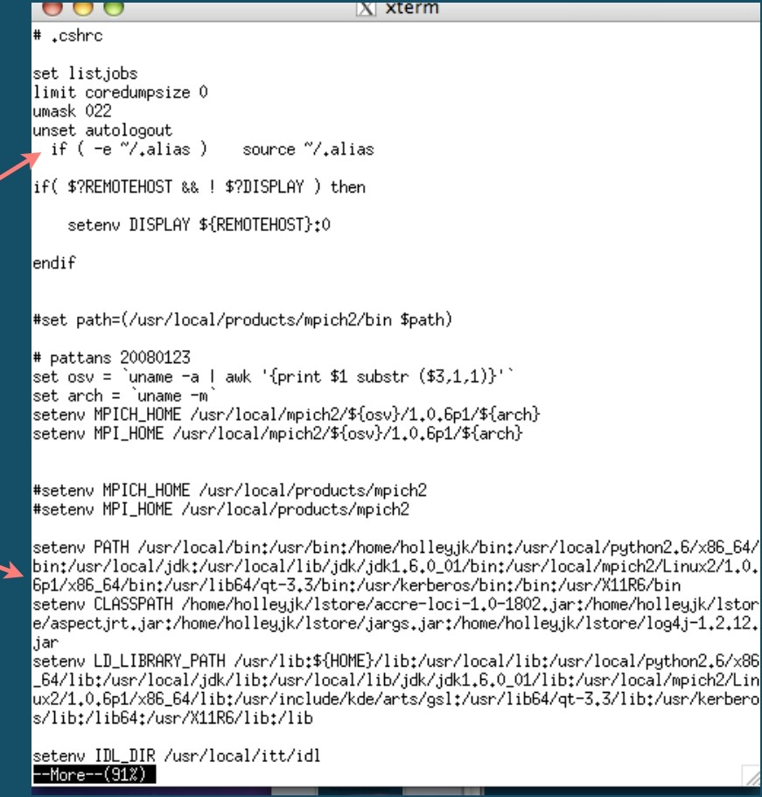
Becoming the Computational Guru of your dreams
Day 2
Setting your shell (how you interface with your operating system)
do a less on cshrc.holleyjk
execute an alias file that nicknames unix commands
tells your system where to look for external commands, like
graphics programs

Slide 86
Becoming the Computational Guru of your dreams
Day 2
Setting your shell (how you interface with your operating system)
Open a web browser to github.com/djsissom Go to bootcamp repository
Click "Clone or Download" button, and choose "Download Zip"
Scp the zip file to your vpac home directory Unzip the file on your laptop (Mac) and on VPAC

Slide 87
Becoming the Computational Guru of your dreams
Day 2
Setting your shell (how you interface with your operating system)
What does `echo $SHELL` return?
Mv bashrc to ~/.bashrc (if it doesn't exist yet...)
Less .bashrc to read it
source .bashrc
will run the file and install your commands

Slide 88
Becoming the Computational Guru of your dreams
Day 2
To change your .bashrc , you need a text editor
emacs <filename> &
Ctl-v -- page up
Esc-v -- page down
Ctl-n -- next line
Ctl-p -- previous line
Esc-< -- top of file
Esc -> -- bottom of file
Esc-Esc-Esc -- get out of hotkey
Ctl-X-S -- save file
Ctl-X-C -- quit
Ctl-k -- kill a line
Ctl-y -- paste line
Esc -% -- query replace
Ctl-x ( -- start macro
Ctl-x ) -- end macro
Example: Ctl-x( Ctl-n Ctl-n Ctl-x
Ctl-x e -- execute macro
Esc-num -- do num times
Ctl-/ -- undo
Practice: Open a new file called ‘motivation’ and write ‘I love emacs with my whole heart!’ 2¹⁶ times. Then, replace ‘heart’
with ‘mind’ on every other line.

Slide 89
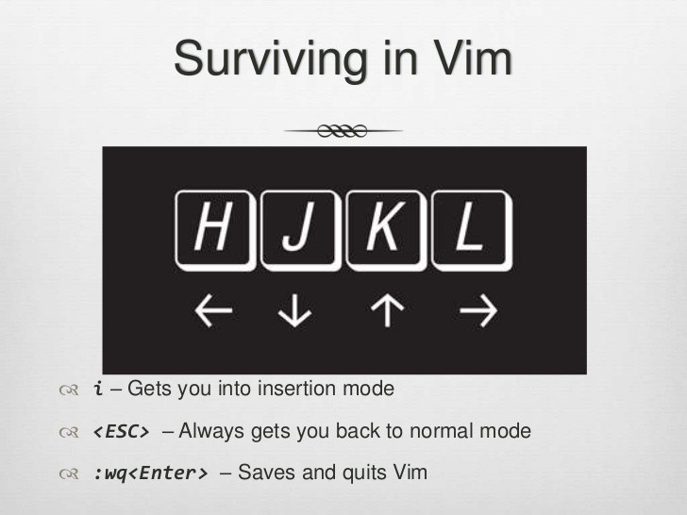
Becoming the Computational Guru of your dreams
Day 2
Editing text files with Vim
Set up vim files (dark terminal recommended)
$ vim .bashrc
More slides at https://www.slideshare.net/
brandonliu/introduction-to-vim
/ - to search and n/N to navigate search results

Slide 90
Becoming the Computational Guru of your dreams
Day 2
Vim walkthrough
https://www.openvim.com/

Slide 91
Becoming the Computational Guru of your dreams
Day 2
Remember the cheat sheet
http://cheatsheetworld.com/pro
gramming/unix-linux-cheat-
sheet/

Slide 92
Day 2
Becoming the Computational Guru of your dreams
For homework:
Add your own nicknames for unix commands -- most useful aliases win a prize!
Add aliases to make rm, mv, and cp safer (check the man pages for the interactive option for each)
Practice with your text editor of choice

Slide 93
Unix Challenge!
-- Find a file with cereal in its name
(hint: it’s in a vpac directory involving /home/holleyjk...)
-- copy it to your home directory, add your name to the filename, and change permissions so that you can read and write to it, but group/other can only read it
-- write the name of your favorite cereal in the file
-- copy it to Kelly's bootcamp/2017 directory and tell me when you’ve done it. First one wins a prize!!

